Slide 1

Automated Processing of Synthetic Aperture Data (SAR) using ESA SNAP Tool
Presented by:
Jayendra Praveen Kumar Chorapalli
M.Sc ESPACE, TU Munich
Under the guidance of:
Prof. Dr. Michael Eineder
TU Munich

Slide 2
Goal:
Monitor amplitude of SAR point targets such as corner reflectors (CRs) or electronic reflectors (ECRs) over time using ESA’s SNAP tool.

Slide 3
Table of Contents
Introduction to SAR
Principle of SAR
SAR Geometry
SAR Radiometry
Sentinel 1 Mission
SAR Preprocessing Steps
Automation of Preprocessing Steps in SNAP Tool
Calculation of Radar Cross Section
Results
Conclusion

Slide 4
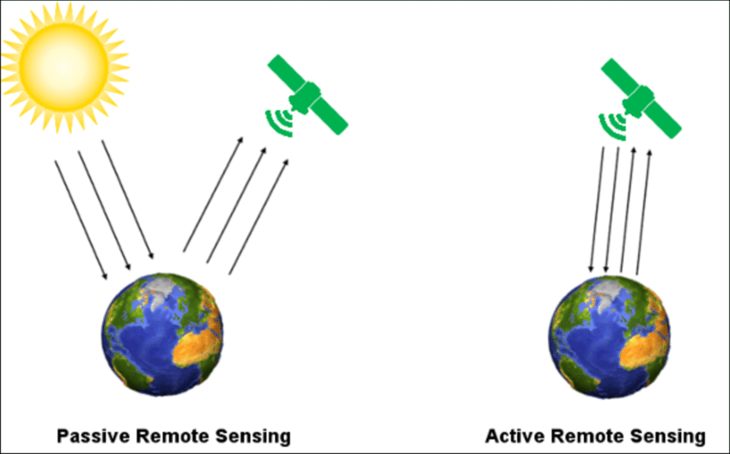
Introduction to SAR (Cont.)
Why do we need SAR?
SAR is an Active Sensor: Day and night imaging capability
Optical Remote Sensing
SAR Remote Sensing
Fig.1: Active vs Passive Remote Sensing
Lopez Ornelas, Fernanda. (2016). The Mexican Water Forest: benefits of using remote sensing techniques to assess changes in land use and land cover. 10.13140/RG.2.2.11855.43685.

Slide 5
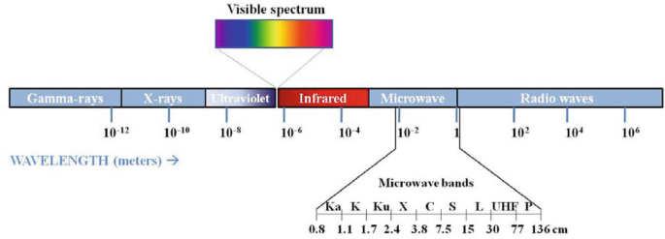
Introduction to SAR (Cont.)
SAR works at longer wavelengths : Weather Independence
SAR
Fig.2: Bands used for SAR Remote Sensing
Srikanth, P., Chakraborty, A., Murthy, C.S. (2021). Crop Monitoring Using Microwave Remote Sensing. In: Mitran, T., Meena, R.S., Chakraborty, A. (eds) Geospatial Technologies for Crops and Soils. Springer, Singapore. https://doi.org/10.1007/978-981-15-6864-0_5
Notes:
The longer the SAR wavelength, the higher is the penetration depth of the SAR signal
X,C,L and Ku bands are mostly used for SAR data.
X,C: Weather Data
L:Traffic Control
Ku: Satellite Altimetry
Finally, and perhaps most importantly, radar illumination is coherent. Radar antennas emit pulses of microwave energy in which the characteristics of the waves are controlled and consistent pulse to pulse. This natural coherence enables the creation of products such as digital elevation models and sensitive measurements of Earth surface changes over time

Slide 6
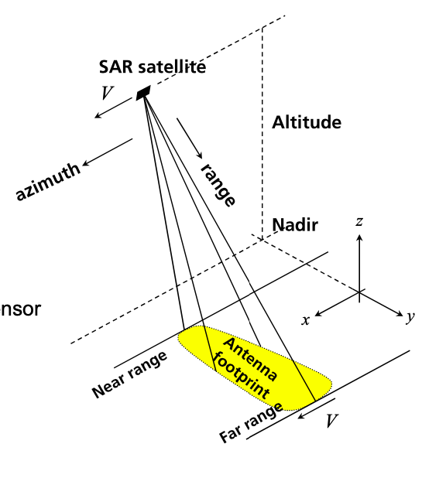
2. Principle of SAR
Imaging principle of SAR:
Range Resolution:
C = speed of light; Wp = Bandwidth
Azimuthal Resolution:
ResA = λ*R/ L (for RAR)
For SAR:
L = Length of Antenna ; λ= Wavelength
R = Range from Antenna to object
Res_{R} = c/2Wp
Res_{A} = L/2
Fig.3: Imaging geometry of SAR
M. Eineder, Introduction to Microwave and SAR Remote Sensing, Winter Semester 2021-2022
Notes:
Range Resolution:
The range resolution of a pulsed radar system is limited fundamentally by the bandwidth of the transmitted pulse. A wide bandwidth can be achieved by a short duration pulse. However, the shorter the pulse, the lower the transmitted energy and the poorer the radiometric resolution. To preserve the radiometric resolution, SAR systems generate a long pulse with a linear frequency modulation (or chirp).
Resolution is the ability of a sensor to separate to objects or points in an image

Slide 7
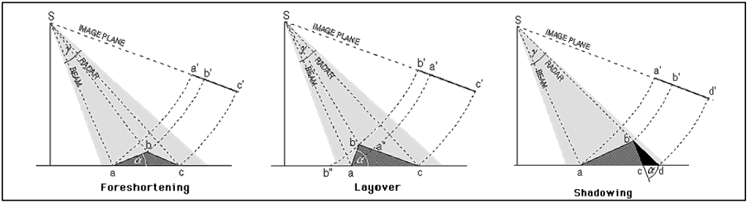
3. SAR Geometry
SAR imaging geometry is complex and hence this leads to distortions due to topography.
Distortions in Geometry:
High Resolution Digital Elevation Model is used to correct these effects.
Foreshortening
Layover
Shadow
Fig.4: Distortions in geometry
https://www.sarmap.ch/pdf/SAR-Guidebook.pdf
Notes:
Note that foreshortening effects can be corrected during the geometric and radiometric calibration assuming the availability of high resolution Digital Elevation Model (DEM) data. Layover and Shadow areas can be exactly calculated, but not corrected. These areas have no thematic information.

Slide 8
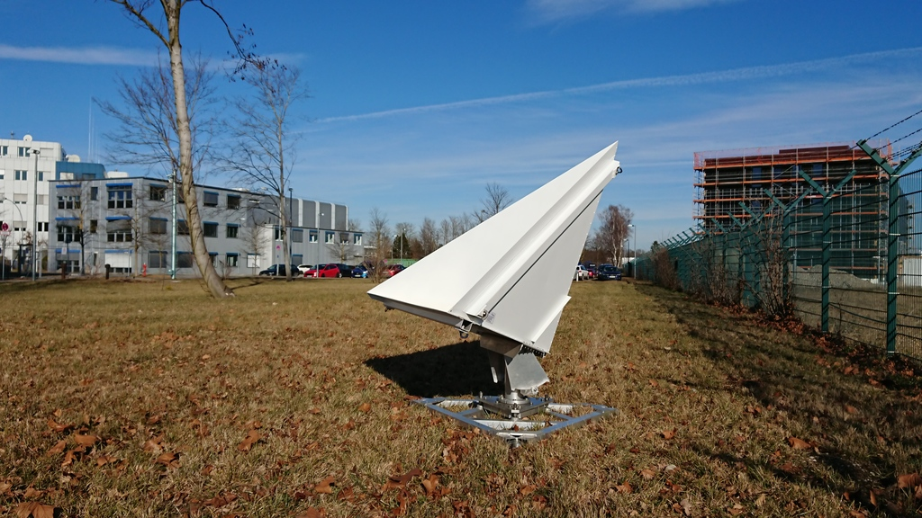
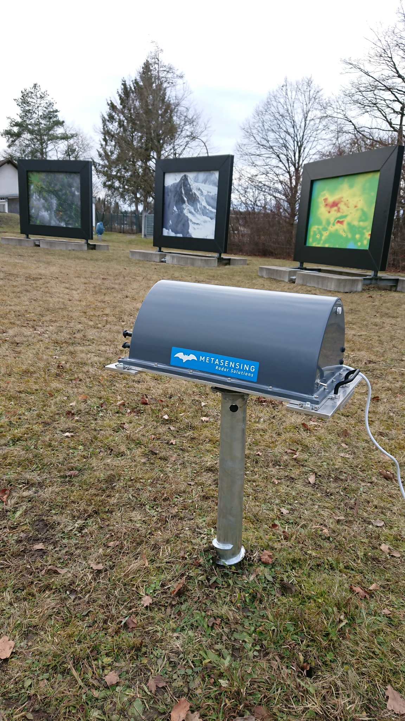
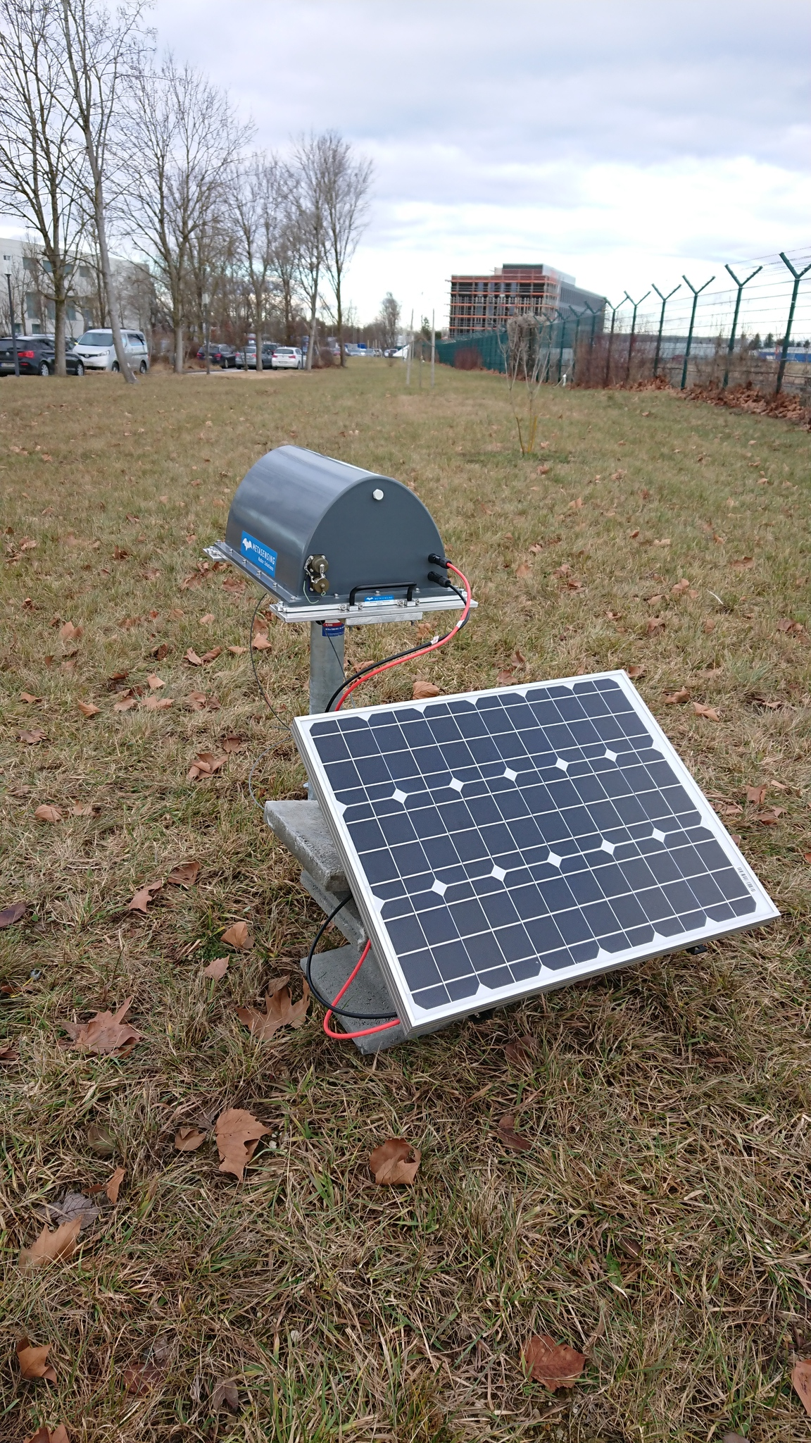
4. SAR Radiometry
Why radiometric calibration is important?
Calibrated SAR images are essential for quantitative use of the data
The radiometric correction is also necessary for the comparison of SAR images acquired with different sensors or modes or at different times.
Point targets such as corner reflectors or electronic corner reflectors are used to calibrate SAR data to measure both radiometric and geometric accuracy.
Fig.5: Corner reflector and electronic corner reflectors (left to right) installed at DLR, Oberpfaffenhofen
M. Eineder, Introduction to Microwave and SAR Remote Sensing, Winter Semester 2021-2022
Notes:
The theoretical backscatter value of the CR is know and this value is compared with the radar backscatter using the concept of Radar Cross Section.
Transponders consist of a receiving antenna, a very stable amplifier loop, and a transmit antenna [1, 6, 13]. The higher the total loop gain (antenna gains and electronic amplification) the brighter a transponder will appear in an acquired grayscale SAR image. If the transponder loop gain and its uncertainty is known prior to an overpass, then the transponder can be used as a measurement standard for the radiometric calibration of a SAR instrument. Utilizing a transponder as a radiometric measurement standard requires the accurate radiometric calibration of the transponder itself. As a dominant contributor to the radiometric uncertainty budget for a SAR instrument, the quality of the transponder calibration has a direct impact on the overall radiometric measurement uncertainty of the SAR instrument.

Slide 9
6. Sentinel 1 Mission
Sentinel 1A and Sentinel 1B provides SAR data in C band
Repeat Cycle:
Sentinel 1A: 12 days
Sentinel 1B :12 days
Altitude: 693 km
Inclination: 98.18°
6 day repeat cycle
Acquisition Modes: | Stripmap: | Interferometric Wide Swath: | Extra Wide Swath:
Swath | 80KM | 250KM | 410KM
Resolution | 5m*5m | 5m*20m | 20m*40m
Application | Emergency requests | Default acquisition over land | Maritime, ice and polar zones
Table 1: Acquisition modes of Sentinel 1 satellite
https://sentinels.copernicus.eu/web/sentinel/missions/sentinel-1/overview/mission-summary
Notes:
Sentinel 1 Mission comprises of 2 satellites 1A and 1B sharing the same orbital plane.
The C-SAR instrument supports operation in dual polarisation (HH+HV, VV+VH) implemented through one transmit chain (switchable to H or V) and two parallel receive chains for H and V polarisation. Dual polarisation data is useful for land cover classification and sea-ice applications.

Slide 10
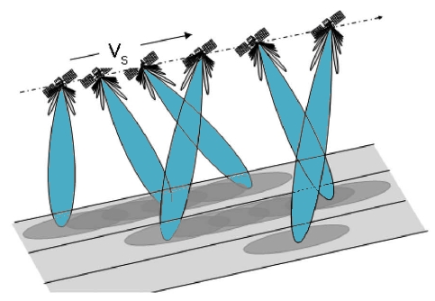
6. Sentinel 1 Mission (Cont.)
Interferometric Wide Swath Mode:
Main acquisition mode of SAR sensors over land
Acquires data with a 250 KM swath at 5m*20m resolution
Captures 3 sub swaths using TOPSAR technique
TOPSAR ~ SCANSAR with extra capabilities
Two products are generated in IW mode of acquisition:
Single Look Complex (SLC)
Ground Range Detected (GRD)
Fig.6: TOPSAR sub swath acquisition
https://sentinel.esa.int/web/sentinel/user-guides/sentinel-1-sar/acquisition-modes/interferometric-wide-swath
Notes:
With the TOPSAR technique, in addition to steering the beam in range as in ScanSAR, the beam is also electronically steered from backward to forward in the azimuth direction for each burst, avoiding scalloping and resulting in homogeneous image quality throughout the swath

Slide 11
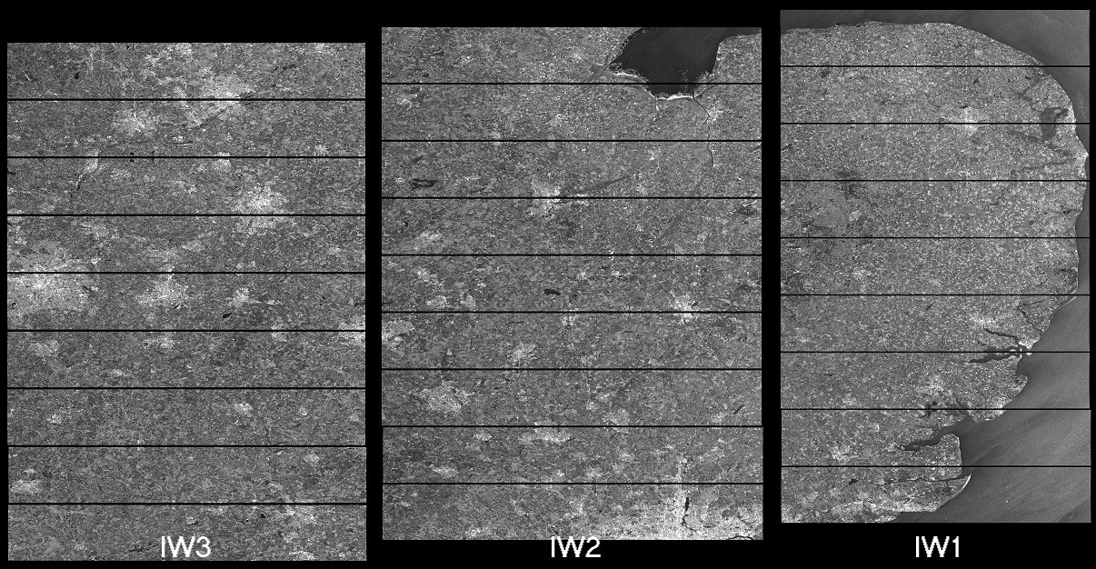
6. SAR Data: Interferometric Wide Swath Mode
SLC Product:
Fig.7:Single Look Complex dataset
https://sentinel.esa.int/web/sentinel/user-guides/sentinel-1-sar/acquisition-modes/interferometric-wide-swath
Notes:
Level 1 data can be separated in two distinct product types, depending if the full complex information is used (amplitude and phase) or only the amplitude information. The product denomination depends on the sensor type; for Sentinel 1 the names Single Look Complex (SLC) and Ground range detected (GRD) are used, respectively. Both products can be generated from the Level 0 data. Level 1 data are the products that are used by most scientific users. The processing toward Level-1 data includes Doppler centroid estimation and data focusing. The Level 1 SLC product consists of the real and imaginary part of focused complex SAR data in slant range geometry, from which the phase and amplitude information can be retrieved. This is available for all acquired polarisations. Additional orbit information for georeferencing is provided with the data. The Level 1 GRD data consist of focused and multi-looked SAR data that have been projected to ground range geometry. GRD data only contain amplitude information, therefore the phase information is lost. The multi-looking step is particular for GRD data and allows both speckle reduction and square pixel resolution. As for the SLC data, the GRD data are annotated with orbit information for georeferencing. The Level-1 products are not calibrated, they include however information about calibration constants, which are sensor dependent. Further processing is needed in order to obtain calibrated radar cross section information from the original data intensity values.

Slide 12
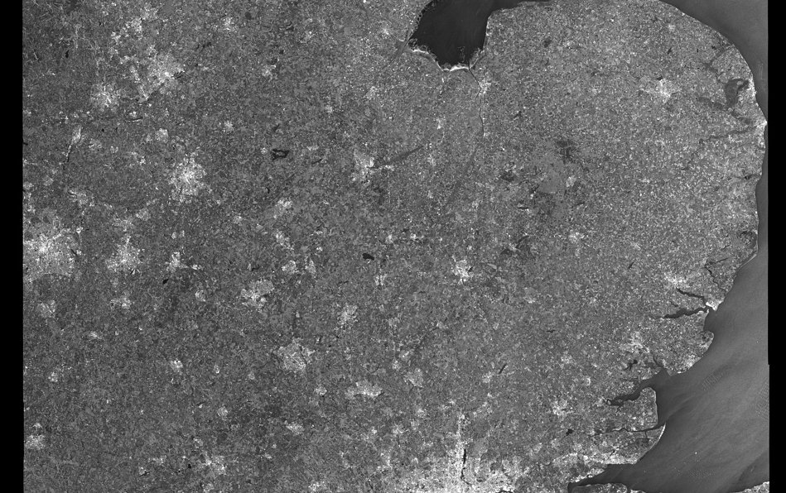
6. SAR Data: Interferometric Wide Swath Mode
GRD Product:
Fig.8: Ground Range Detected dataset
https://sentinel.esa.int/web/sentinel/user-guides/sentinel-1-sar/acquisition-modes/interferometric-wide-swath
Notes:
Level 1 data can be separated in two distinct product types, depending if the full complex information is used (amplitude and phase) or only the amplitude information. The product denomination depends on the sensor type; for Sentinel 1 the names Single Look Complex (SLC) and Ground range detected (GRD) are used, respectively. Both products can be generated from the Level 0 data. Level 1 data are the products that are used by most scientific users. The processing toward Level-1 data includes Doppler centroid estimation and data focusing. The Level 1 SLC product consists of the real and imaginary part of focused complex SAR data in slant range geometry, from which the phase and amplitude information can be retrieved. This is available for all acquired polarisations. Additional orbit information for georeferencing is provided with the data. The Level 1 GRD data consist of focused and multi-looked SAR data that have been projected to ground range geometry. GRD data only contain amplitude information, therefore the phase information is lost. The multi-looking step is particular for GRD data and allows both speckle reduction and square pixel resolution. As for the SLC data, the GRD data are annotated with orbit information for georeferencing. The Level-1 products are not calibrated, they include however information about calibration constants, which are sensor dependent. Further processing is needed in order to obtain calibrated radar cross section information from the original data intensity values.

Slide 13
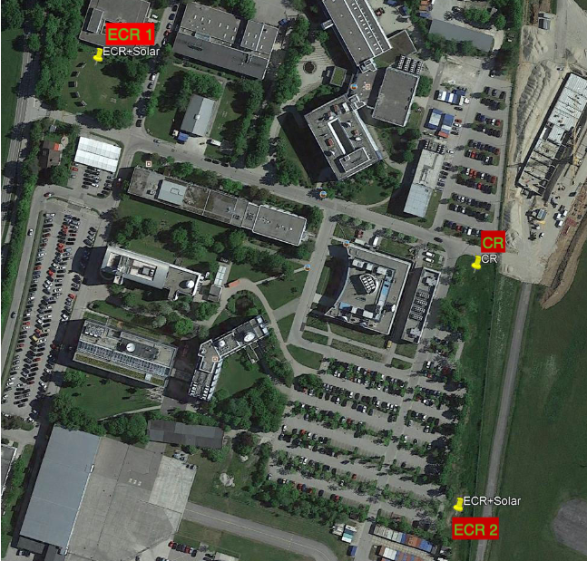
6. SAR Datasets
Study area and Point targets:
Datasets used:
Sentinel 1A IW Mode L1 products:
S1A_IW_GRDH_1SDV_20210813*
S1A_IW_GRDH_1SDV_20210906*
S1A_IW_GRDH_1SDV_20210918*
S1A_IW_GRDH_1SDV_20210930*
S1A_IW_GRDH_1SDV_20211012*
S1A_IW_GRDH_1SDV_20211024*
S1A_IW_GRDH_1SDV_20211129*
Pre-processing:
ESA SNAP
RCS Calculation and plots:
Python
Fig.9: Point target locations at DLR, Oberpfaffenhofen
Notes:
Sentinel 1 Mission comprises of 2 satellites 1A and 1B sharing the same orbital plane.
The C-SAR instrument supports operation in dual polarisation (HH+HV, VV+VH) implemented through one transmit chain (switchable to H or V) and two parallel receive chains for H and V polarisation. Dual polarisation data is useful for land cover classification and sea-ice applications.

Slide 14
6. SAR Preprocessing Steps
Preprocessing steps of Sentinel 1A data to monitor amplitude of point targets:
Level :
Sentinel1_GRD_IW_* : Band: Amplitude VV
Subset
Apply-Orbit-File
Radiometric Calibration
Range Doppler Terrain Correction
Sigma0_VV:
Sentinel1_GRD_IW_*
Fig.10: Preprocessing steps to measure amplitude of point targets
M. Eineder, Determining Radar Cross Section with SNAP, 2022

Slide 15
7. Automation of SAR Preprocessing Steps (Cont.)
The following are the ways to perform Automation of the above mentioned preprocessing steps:
SNAP ESA: Developed on java
Python: SenSARP, PyroSAR, Snappy etc.,
We will use SNAP ESA tool to automate the of preprocessing our data.
But how?
GRAPH BUILDER
Advantages: Reduces the human effort for the repetitive tasks.

Slide 16
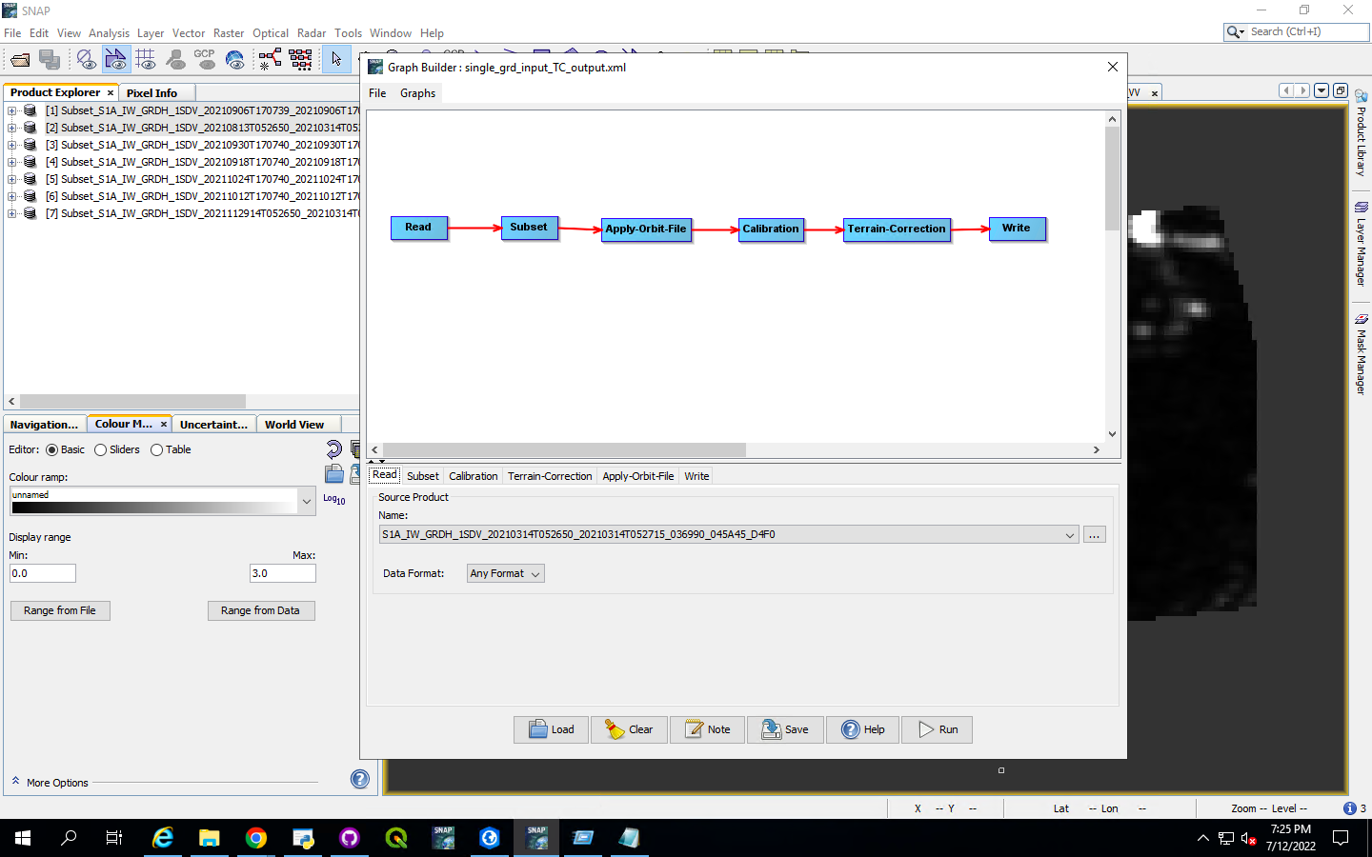
7. Automation of SAR Preprocessing Steps (Cont.)
GRAPH BUILDER
The graph builder used to automate the preprocessing for the above 5 sentinel 1 datasets is shown below:
Fig.11: Graph builder used for preprocessing SAR images

Slide 17
8. Calculation of Radar Cross Section
The following steps are performed to calculate the Radar Cross Section (RCS) of the 3 point targets we are interested in:
Step 1: Select the preprocessed product and scale the display range
Step 2: Draw a small rectangle around the point targets and its side lobes.
Step 3: Select geometry under the analysis tab to know the mean backscatter value and convert it into RCS+Clutter (using python)
Note: To convert Sigma0 value of one pixel to RCS, it should be multiplied with the pixel area
Step 4: Correct the peak of the clutter power RCS by removing the background clutter (using python)
M. Eineder, Determining Radar Cross Section with SNAP, 2022

Slide 18
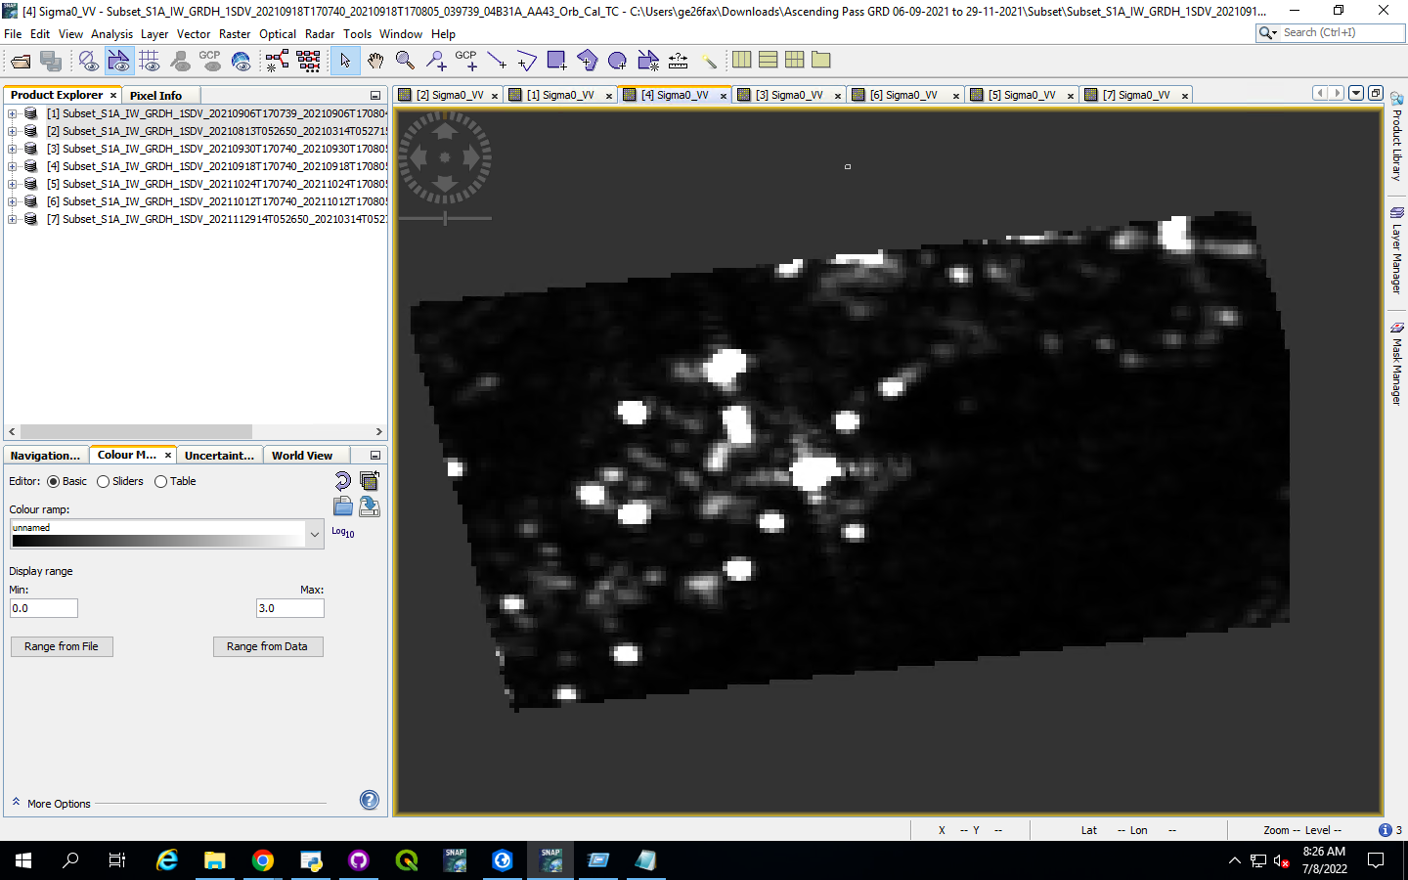
8. Calculation of Radar Cross Section (Cont.)
Example calculation of RCS of CR captured on 09-18-2022:
Step 1: Display and scale:
Fig.12: Preprocessed SAR data 09-18-2021

Slide 19
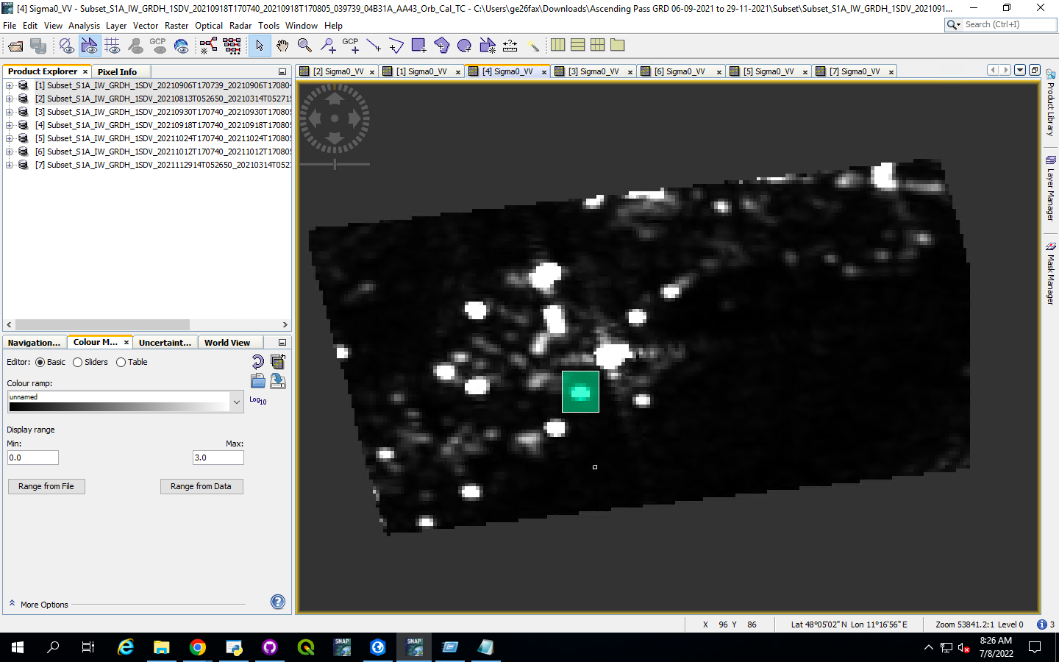
8. Calculation of Radar Cross Section (Cont.)
Example calculation of RCS of CR captured on 09-18-2022:
Step 2: Drawing a Rectangular box
Fig.13: Geometry to measure RCS+CL for CR

Slide 20
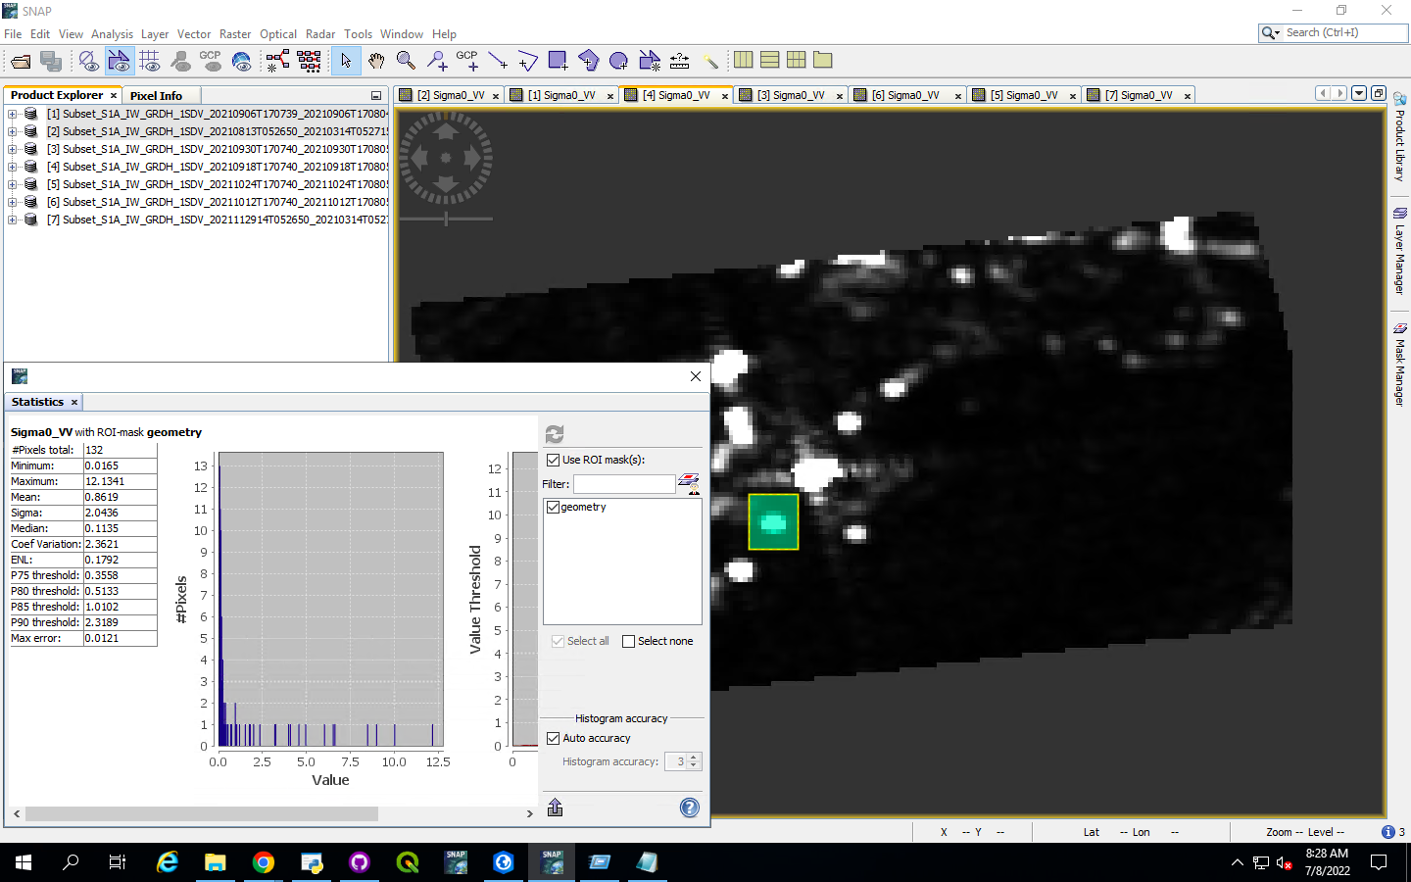
8. Calculation of Radar Cross Section (Cont.)
Example calculation of RCS of CR captured on 09-18-2022:
Step 3: Statistical window of mean backscatter of RCS+CL
Fig.14: Mean sigma0 value (RCS+CL) for CR

Slide 21
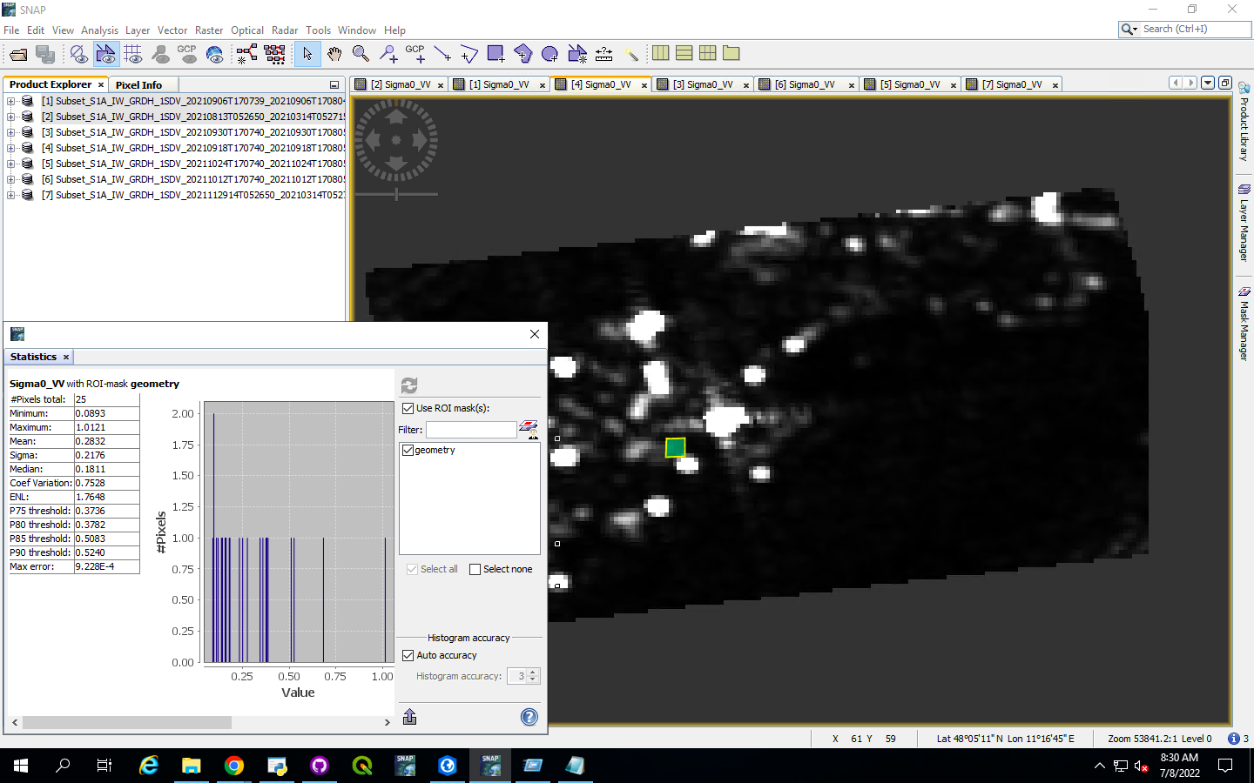
8. Calculation of Radar Cross Section (Cont.)
Example calculation of RCS of CR captured on 09-18-2022:
Step 4: Statistical window of mean backscatter of background clutter (CL)
Fig.15: Mean sigma0 value (CL) for CR

Slide 22
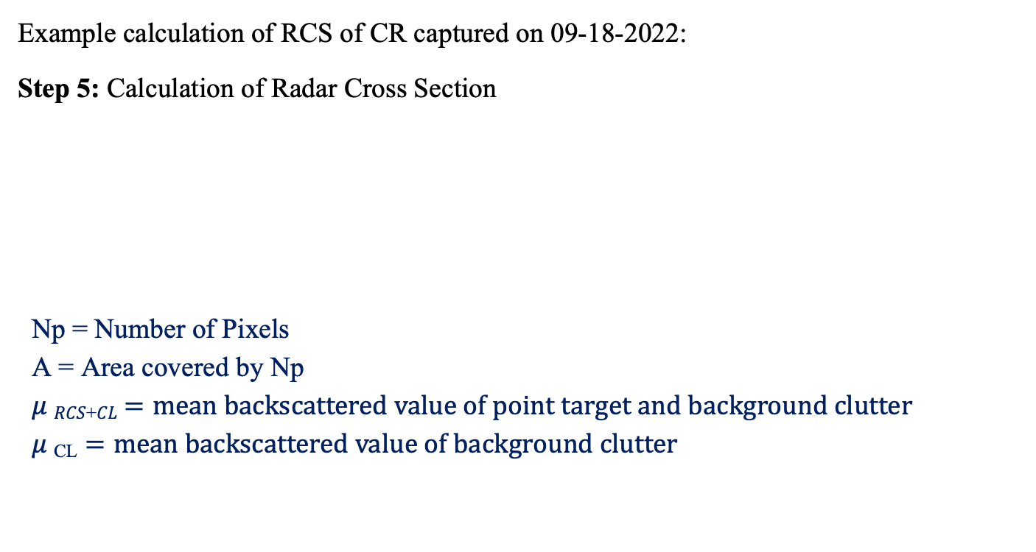

8. Calculation of Radar Cross Section (Cont.)
Example calculation of RCS of CR captured on 09-18-2022:
Step 5: Calculation of Radar Cross Section
Np = Number of Pixels
A = Area covered by Np
𝜇 _{𝑅𝐶𝑆+𝐶𝐿} $=mean backscattered value of point target and background clutter$
𝜇 _{CL} $=mean backscattered value of background clutter$
RCS = 10log₁₀ (Np * A* ($μ RCS+CL$ - $μ CL$))
https://github.com/jayepraveen999/ESPACE-Seminar-2022--Automation-of-SAR-Preprocessing
Notes:
Units of RCS

Slide 23
9. Results
The following is table showing RCS values of three point targets (CR, ECR1, ECR2):
Theoretical backscatter for 1.5m trihedral CR = 38.3dB
S.No: | SAR IMAGE DATE: | RCS of CR: | RCS of ECR1: | RCS of ECR2:
1 | 08-13-2021 | nan | 42.09 | 36.81
2 | 09-06-2021 | nan | 42.12 | 39.98
3 | 09-18-2021 | 38.83 | 44.08 | 40.07
4 | 09-30-2021 | 37.96 | 43.11 | 39.89
5 | 10-12-2021 | nan | 43.95 | 41.24
6 | 10-24-2021 | nan | 44.64 | 39.24
7 | 11-29-2021 | nan | 44.81 | 41.25
Table 2: RCS values of point targets measured from SAR data

Slide 24
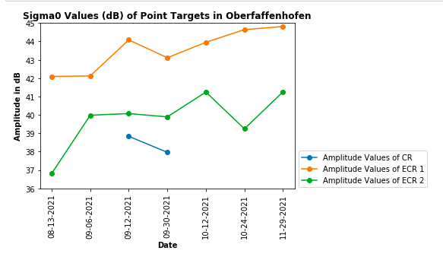
9. Results (Cont.)
The following is a plot between RCS of the point targets (CR, ECR1, ECR):
Fig.16: Amplitude over time graph of point targets
https://github.com/jayepraveen999/ESPACE-Seminar-2022--Automation-of-SAR-Preprocessing

Slide 25
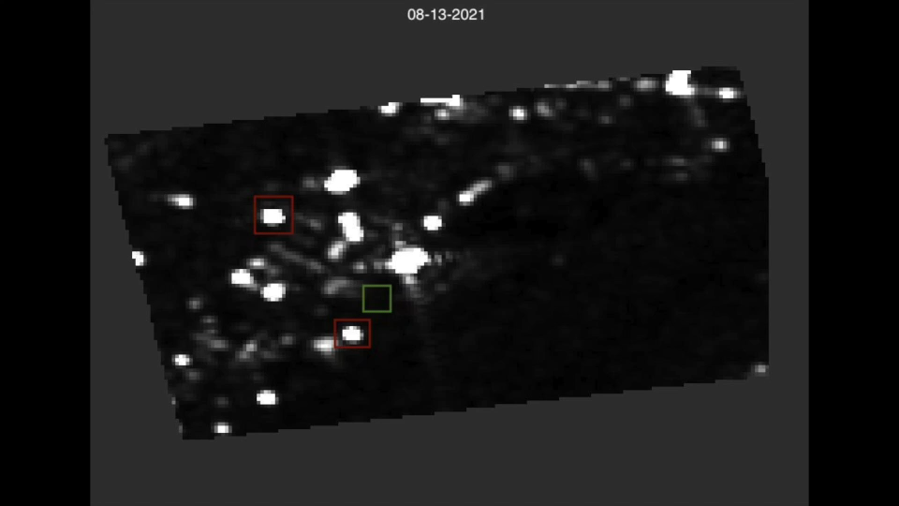
9. Results (Cont.)
Time series video of the preprocessed SAR images:

Slide 26
10. Conclusion
Due to complex imaging technique of SAR sensors, preprocessing steps are necessary for the quantitative use.
Corners reflectors are used to calibrate SAR sensors so that data from different sensors can be used together.
The RCS of CR is very close to the theoretical value and the possible reasons for the offset of these values could be the effect of atmosphere and the surrounding environment.
The RCS values for the ECRs has a 3-4dB fluctuations and this depends on internal gain setting of the amplifier and may changed after opening or closing the box.
ECRs are mostly used to measure the location accuracy of the SAR data.

Slide 27
Thank you!

